Slide 1
What is a transparent, comprehensive and effective budget classification from the perspective of the Government and of the Parliament?
Chiara Goretti, Senato della Repubblica, Italy
7° Cesee
Zagreb, 30th June 2011

Slide 2
Outline
Definitions and perspectives
Classifications for budgeting
Classifications for analytical purposes
The Italian budget
Conclusions

Slide 3
The Budget Classifications
Classify: arrange a group in classes or categories according to shared qualities or characteristics
Budget classification is the grouping of revenues and expenditure according to specific characteristics
Two different perspectives:
Represents the dimension of budget authorization/ appropriation (unique);
defined in budget laws;
Relevant mainly on the expenditure side;
Analytical purposes (the more, the most useful)

Slide 4
THE CLASSIFICATIONS
FOR BUDGETING

Slide 5
Classifications for budgeting
Budget classification is an indicator of the relationship :
between parliament and executive
allocation of resources and accountability to citizens
Managers’ accountability
administrative efficiency
Provides a normative framework for both decision-making and accountability
One of the tools to pursue quality of spending

Slide 6
Legislature-executive
Budgetary specification: principle under which appropriations must be use for the specific purpose laid down in the budget
Historical role of parliaments in controlling budgets
“…limitations gradually draw closer, and the legislature ties the hands of the executive more and more. These are precisely the steps by which financial history, from the beginning of the century, has gradually developed.
Budgetary specification has developed from a vote en bloc by ministry to a vote by section of a ministry; finally, it has come to a vote by chapter, where it now stands, showing the tendency to descend as far down as to the vote by paragraph and by article in accordance with [legislative] suggestion”. (The Budget, Renè Stourm)
Classifying expenditures correctly is important for policy formulation and resources allocation
Helps the proper allocation of scarce resources supported by the clear definition of spending priorities

Slide 7
Efficiency and managerial responsibility
Budget appropriation could be based on:
organization - agencies
inputs
programs
However, increasingly focus is on classification system capable of linking funding to results rather than inputs.
Budget classification is today one of the fundamental building blocks of a sound management system

Slide 8
Program budgeting and performance focus
Classification by programs is a basic information tool used by most contemporary performance budgeting systems
intended to introduce clarity about the objectives being pursued through public expenditure
New wave focusing on the need to improve the effectiveness and cost efficiency of public spending
relaxation of inputs
program budgeting
managerial accountability
accrual accounting
performance indicators and information on results

Slide 9
THE CLASSIFICATIONS
FOR ANALYTICAL PURPOSES

Slide 10
Functional Classification: COFOG
The Classification of the functions of government (COFOG), developed in 1999 by the OECD and published by the UN Statistical Division as a standard classifying the purposes of government activities.
3 levels of detail:
Divisions
describe the broad objectives of government
groups
classes
both define the means by which these broad objectives are achieved
These functions are designed to be general enough to apply to the government of different countries. The value is that different countries can be compared.

Slide 11
COFOG: first level
United Nations functional classification (COFOG)
1. General public services
2. Defense
3. Public order and safety
4. Economic affairs
5. Environmental protection
6. Housing and community amenities
7. Health
8. Recreation, culture and religion
9. Education
10. Social protection
5.1 - Waste management
5.2 - Waste water management
5.3 - Pollution abatement
5.4 - Protection of biodiversity and landscape
5.5 - R&D Environmental protection
5.6 - Environmental protection n.e.c.

Slide 12
The Economic Classification: ESA 95
Any type of budget classification should be capable of being broken down into relevant inputs for analysis purposes.
European System of Accounts ESA 95
economic classification identifies different categories of inputs.
Economic classification is relevant for the macroeconomic stabilization function and for statistical reasons

Slide 13
The Economic Classification: ESA 95
Total general government expenditure is defined in ESA95 by reference to a list of categories.
First level:
intermediate consumption
compensation of employees
interest
social benefits
subsidies
other current expenditure
capital transfers payable
capital investment

Slide 14
THE ITALIAN BUDGET

Slide 15
The State budget
Several reforms in budget structure reflecting also the change in role of Parliament
Since 2008: missions and programs
Change in number and dimension of programs; not completed in terms of administrative alignment; difficulties in program definition because mainly transfer budget

Slide 16
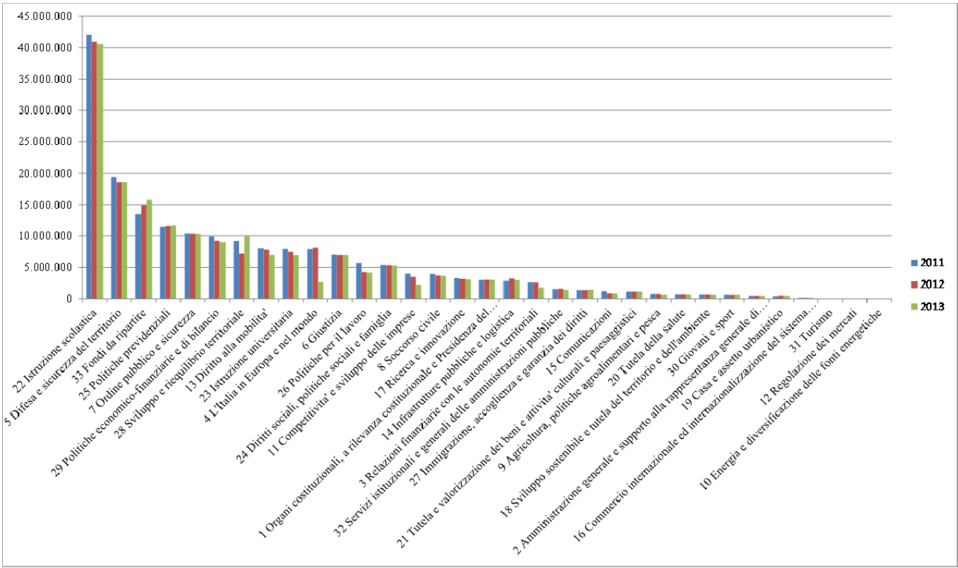
State budget missions
Al netto dei trasferimenti e delle regolazioni contabili

Slide 17
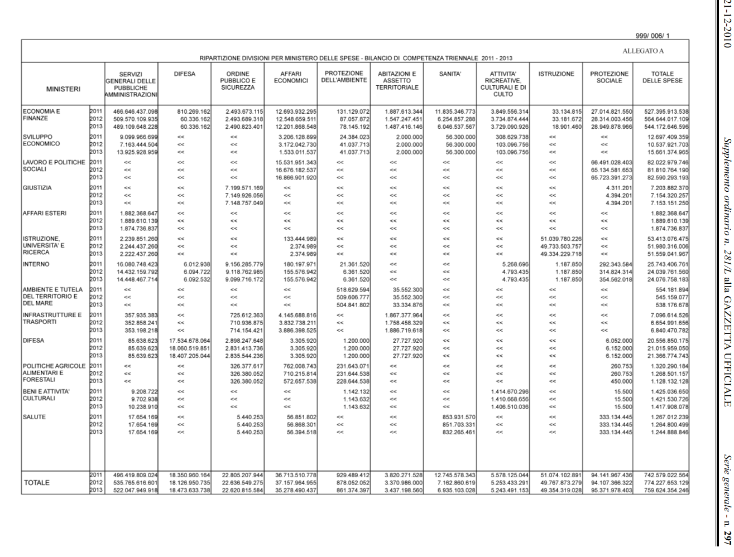

Slide 19
Conclusions
Transparency: program definition, alignment with administrative organization;
appropriation or legislation supremacy;
Transparency: connections with economic and functional classification;
Budget classification is one of the tools (medium-term planning; managerial responsibility, performance indicators, accrual);

Slide 20
THANK YOU FOR YOUR ATTENTION

